Slide 1
Presentation brief for MCT’s
Title of presentation | Build reports using Power BI integration with Azure Synapse Analytics
Presentation\Lab length | Presentation: 10 – 15 minutes Lab: 50 – 60 minutes
Audience | Data Professionals, Data Architects, Business Intelligence Professionals, Developers
Purpose | This module is not intended to teach students how to use Power BI This module is intended to show how Power BI integrates with Azure Synapse Analytics
(think) Student key takeaways | The student should understand how to integrate a Power BI workspace into Azure Synapse Analytics The student should understand how Power BI can reference Azure Synapse Analytics datasets The student should know how to optimize and improve Power BI performance in Azure Synapse Analytics
(feel) Student desired mindset | The student should feel that they can work with Power BI inside Azure Synapse Analytics The student may feel that they understand the performance optimization options available
(do) Student outcomes | The student should be able to integrate a Power BI workspace into Azure Synapse Analytics The student should be able to implement options to improve Power BI performance
More information | For MCT course feedback, visit the Microsoft Official Courseware forum
Notes:
Instructor notes and guidance
This slide is for MCT use only, outlining the aims and objectives of this module.

Slide 2
DP-203T00: Build reports using Power BI integration with Azure Synapse Analytics
Notes:
Instructor notes and guidance
In this module, it is important to make clear to the students that this module will not deep dive into Power BI. It is intended to provide details on how Power BI integrates with Azure Synapse Analytics. It will also show you how you can improve the performance of the reports making use of some Azure Synapse Analytics features.
Also share with students that creating visualizations is a task that data engineers are sometimes asked to perform, and that Power BI can be used to create reports and dashboards against Azure Databricks and Azure Data Lakes independently of Azure Synapse Analytics.

Slide 3

Agenda
Lesson 01 – Build reports using Power BI integration with Azure Synapse Analytics
Notes:
Instructor notes and guidance
This space has been left deliberately blank.

Slide 4
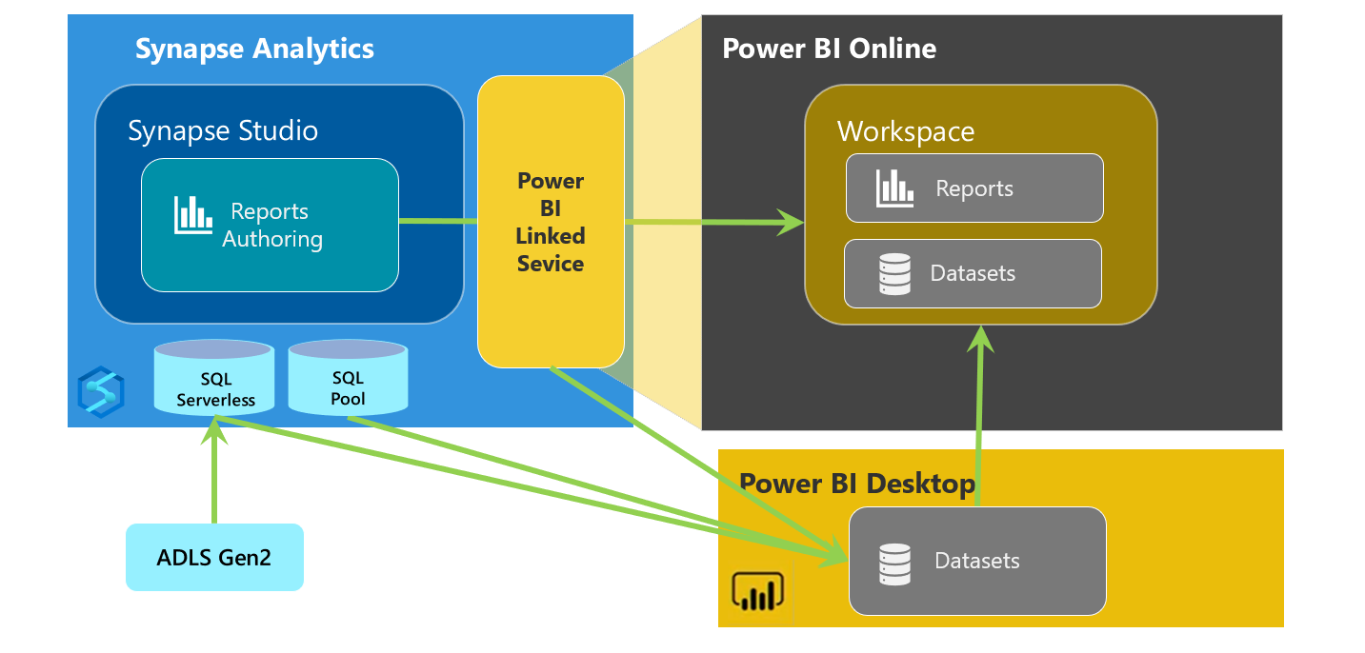
Azure Synapse Analytics and Power BI integration
Optimize with:
Materialized views
Result-set caching
Notes:
Talking points
This diagram should be used to show how Azure Synapse Analytics integrates with Power BI. You can begin by discussing how Linked services can be used to connect to a Power BI workspace and this is embedded into Azure Synapse Studio. You can also describe how Power BI datasets can refer to serverless SQL pool and dedicated SQL pool for the source data for the reports. You can then explain the basic working of Power BI, how you initially “Get Data” to retrieve data in the data set and explain to the students how this is used as the basis to create a reports.
Instructor notes and guidance
As the focus is on how Power BI integrates with Azure Synapse Analytics, use this slide to explain the integration, this the key objective of this module. Consider demoing Power BI to the students if you wish for greater impact. Explain to the student to think about using native Azure Synapse Analytics features to optimize the query performance for the reports held in Power BI using materialized views and result set cache. It may be a repetition of previous content but is a useful timely reminder of how these features can provide benefits to the consumers/business user of the reports. After all, for most people in the business, the reports are how users see the analytical solution, and report the problems.
Recommended reading for this slide
Build reports using Power BI within Azure Synapse Analytics - Learn | Microsoft Docs

Slide 5
Review questions
Q01 – Which Power BI and Azure Synapse Analytics can be brought together to provide integrated visualizations within Azure Synapse Analytics ?
A01 – Workspace
Q02 – In which hub of Azure Synapse Studio can you create and author Power BI reports?
A02 – The Develop hub
Q03 – Which Azure Synapse Analytics performance optimization can be used to enable instant query response time predictable and repetitive query patterns?
A03 – Result-set caching
Notes:
Instructor notes and guidance
This space has been left deliberately blank

Slide 6
Lab: Build reports using Power BI integration with Azure Synapse Analytics
Notes:
Instructor notes and guidance
This space has been left deliberately blank

Slide 7
Lab overview
In this lab, the student will learn how to integrate Power BI with their Azure Synapse workspace to build reports in Power BI. The student will create a new data source and Power BI report in Azure Synapse Studio. Then the student will learn how to improve query performance with materialized views and result-set caching. Finally, the student will explore the data lake with serverless SQL pools and create visualizations against that data in Power BI.
Lab objectives
After completing this lab, you will be able to:
Build reports using Power BI integration with Azure Synapse Analytics
Notes:
Instructor notes and guidance
In exercise 1 of this lab, the students will perform common tasks associated with working with Power BI. This will include logging into Power BI through Azure Synapse Analytics, creating datasets and writing queries which will be used as a basis for creating a simple report. The intention is to ensure that the Power BI fundamentals are covered to create a report, the students will not deep dive into the complexities of Power BI.
Once done, in exercise 2 the students will explore the Power BI optimization options that are available, focusing specifically on result-set caching and materialized views as methods to ensure consistent performance of the Power BI report queries against Azure Synapse Analytics.
In exercise 3, the students will create reports against serverless SQL pools and dedicated SQL pools so that they can see the difference between each.

Slide 8











Lab 16 Overview
asacosmosdb<unique_suffix>
CosmosDB
Campaign Info
Azure Databricks
asagadatalake<unique_suffix>
Cluster
Azure Data Lake
wwi-02
Sales (parquet)
dp203sql<unique_suffix>
SourceDB
Azure Synapse Analytics
Dedicated SQL Pool (SQLPool1)
Built-In Serverless SQL Pool
Apache Spark pool
Pipelines and Dataflows
Power BI
asagaworkspace<unique_suffix>
Notes:
This slide is an optional slide that you can use to show a high-level overview of the technologies used in the lab.
In this lab, the student will learn how to integrate Power BI with their Azure Synapse workspace to build reports in Power BI. The student will create a new data source and Power BI report in Azure Synapse Studio. Then the student will learn how to improve query performance with materialized views and result-set caching. Finally, the student will explore the data lake with serverless SQL pools and create visualizations against that data in Power BI.

Slide 9
Lab review
Question 1 – When selecting a Power BI dataset, when you define a data source, what type of file do you download?
Question 2 – Which connection setting enables you to connect to a data source live?
Question 3 – Which area of the Monitor hub in Azure Synapse Studio allows you to check the query execution?
Question 4 – Where is the result-set cache held in Azure Synapse Analytics?
Notes:
Answers
Question 1 – The Power BI Desktop Source (PBIDS) file is the file you download and is a JSON object file that aids users connecting to data sources
Question 2 – DirectQuery
Question 3 – SQL requests allows you to look at the queries behind your visualizations to see if they are performant
Question 4 – The operations to create result set cache and retrieve data from the cache happen on the control node of a Synapse SQL pool instance.

Slide 10
Module summary
In this module, you have learned about:
Build reports using Power BI integration with Azure Synapse Analytics
Next steps
After the course, if you want to learn more about Power BI, review the [Microsoft Data Analyst Associate Certification] for detailed information on how you can deep dive into Power BI.
Notes:
Instructor notes and guidance
The next steps is suggested post course learning materials to reinforce what they have learned in the module.

Slide 11
Closing slide
Notes:
Instructor notes and guidance
This space has been left deliberately blank

